Slide 1
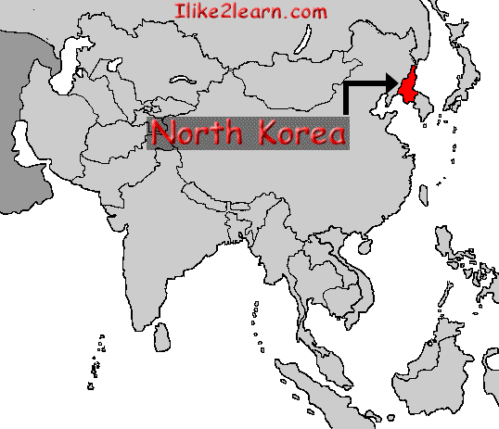
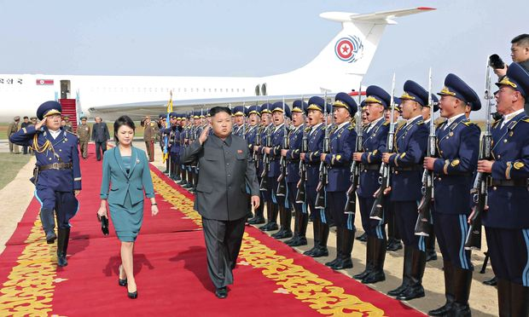
North Korea

Slide 2
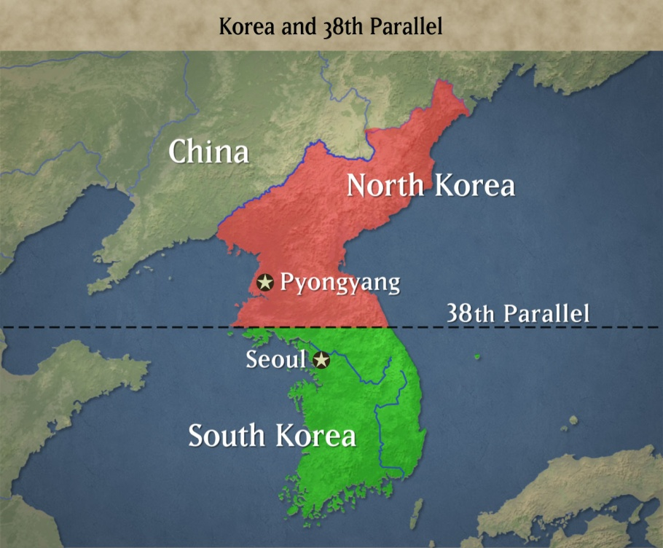
History
After World War II, Japanese occupation of Korea ends with Soviet troops occupying the north, and US troops the south
North Korea's Communist Party inaugurated. Soviet-backed leadership installed, including Red Army-trained Kim Il-sung.
Democratic People's Republic of Korea (DPRK) proclaimed, with founder Kim Il-sung installed as leader. Soviet troops withdraw.
Click picture for short video.

Slide 3
Government
Dictatorship that believes in communism
Militant style- combative and aggressive in support of politics, and typically favoring extreme, violent, or confrontational methods.
Label their government as, “Democratic People's Republic of Korea”
Government controls internet
Government selects leader
Has reeducation camp for dissidents (people with different views)
TV and news is provided by the government only

Slide 4
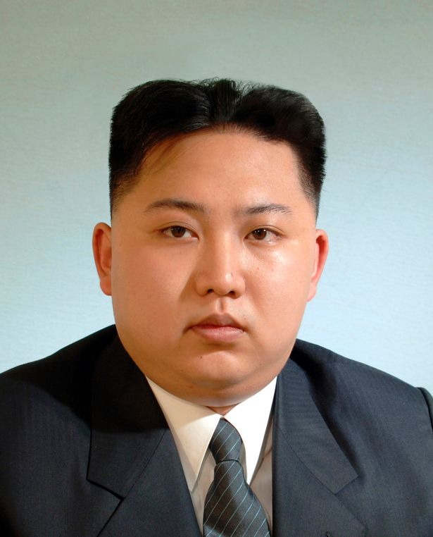
Leader
Kim Jong-un
Came to power after the death of
his father, Kim Jong-il
He is the third family member to rule North Korea

Slide 5
Rights and Responsibilities
Limited rights
Limited voting
Cannot get rich
Must obey government
Can be brutally punished
Can be sent to labor camps
Must serve two years in the army
Does not promote religion
Citizens cannot leave North Korea

Slide 6
Economy
Communist Government
Government owns all businesses and natural resources
Government provides citizens with basic needs
No competition in social classes (usually poor)
Famine is a serious problem
Exports: clothing, plastics, minerals
Imports: food, electronics, chemicals
Trading Partners: China, South Korea, India, Thailand

Slide 7
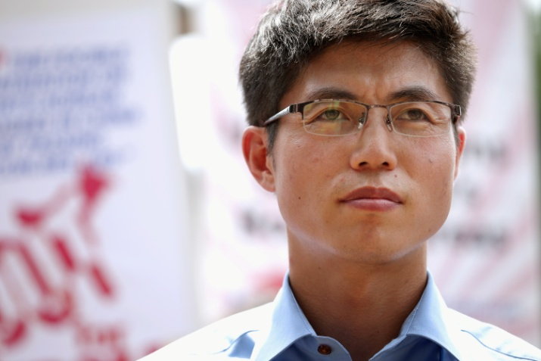
The only known person to escape from a North Korean prison camp
A video of Shin, a man who escaped from a North Korean prison camp.
Last fall, the North Korean government released a propaganda video showing Shin’s father. In the video, his father says that Shin never lived in a political prison camp.
Shin has said that the North
Korean government was forcing
his father to lie.

Slide 8
It was found that some parts of Shin’s story were altered
“When I agreed to share my experience for the book, I found it was too painful to think about some of the things that happened,” he said. “So I made a compromise in my mind. I altered some details that I thought wouldn’t matter. I didn’t want to tell exactly what happened in order not to relive these painful moments all over again.”
“I didn’t realize that changing these details would be important,” he said. “I feel very bad that I wasn’t able to come forward with the full truth at the beginning.”

Slide 9
What did he alter?
For the first time, Shin now says he twice escaped from Camp 18 when he was a teenager, first in 1999 and then in 2001. After the first escape, he was caught within a couple of days. Following his second escape, he managed to travel to China. But police arrested him there, he said, and sent him back to North Korea. Guards returned him first to Camp 18 and then, for punishment and torture, to Camp 14, Shin said in the interview.
In the phone interview, Shin said that he was actually tortured much later, when he was 20. It happened, he said, after his return from China. In Camp 14 in 2002, he said, guards confined him in an underground prison for 6 months, where he was repeatedly burned and tortured

Slide 10
Daily Life
https://www.youtube.com/watch?v=u2nhmI8ihAQ (30 minutes documentary-hidden camera footage)
Photographer is banned from North Korea
Main City

Slide 11
Sports
Soccer is the most popular sport, and men and women each have their own soccer leagues
Volleyball is one sport men and women play together, usually in parks
Children like to do gymnastics and tae kwon do (a traditional Korean martial art that uses punches, high kicks, and jumps)
The wealthiest North Koreans in Pyŏngyang can play golf or go bowling
Other popular sports include swimming, baseball, basketball, and table tennis.

Slide 12
Food
Families sit on the floor around a low table to eat. They use soup spoons and metal chopsticks. Each person at the table has a rice bowl and a soup bowl.
Today, many of these traditions have changed because of the country's famines and the government's food restrictions
In the past, the government provided food to the people through the public distribution system. But in the mid-1990s, floods and droughts caused massive famines, and the public distribution system stopped providing enough food. Between 1 million and 3 million North Koreans died of starvation.
Today, food rations usually include only one or two meals of rice each day. Almost half of all children suffer from malnutrition (not getting enough nutrients)
Many people no longer trust the government to provide them with enough food. Often, North Koreans trade and buy food in illegal markets to get by. In the countryside, people gather wild nuts and roots to add to their meals.

Slide 13
School
Education is free in North Korea (start at age 5)
Students attend at 11 years of school
Teachers are not always paid in North Korea.
Often, a teacher arrives at school in the morning and copies pages from a textbook onto the blackboard for the students to copy in their own notebooks. Then the teacher leaves to go work a second job in order to make a living.
Some students do not go to college
Those who do attend university have over three hundred schools to choose from.
Kim Il Sung University is the best
Students there can study history, politics, the Korean language, physics, chemistry, and more.

Slide 14
Life as a child
The leaders of North Korea keep tight control over information coming in and going out of the country
Some children manage to watch South Korean TV shows that have been smuggled into the country
If their family is caught, the punishment can be serious
Families have to watch TV quietly and keep it a secret
Most North Korean children live with their parents and siblings, but there are some homeless children
They are called kotchebi ("fluttering swallows")
Their parents have died or can't look after them
They survive by looking for food in the markets in town or by singing at railway stations for money.

Slide 15
“The Interview” Movie about North Korea
“The recent hype surrounding The Interview has reached North Korea. The country's citizens are becoming more and more aware of this comedy, which depicts a couple of bumbling media journalists attempting to assassinate their leader Kim Jong-un.”
“citizens pay as high as $50 for a copy on the black market. This is reportedly ten times higher than the average asking price of the most popular South Korean TV shows that are sold illegally.”

Slide 16
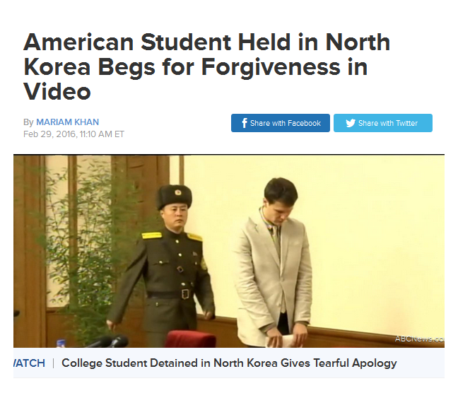
Detainees
Click picture for article

Slide 17
